Slide 1

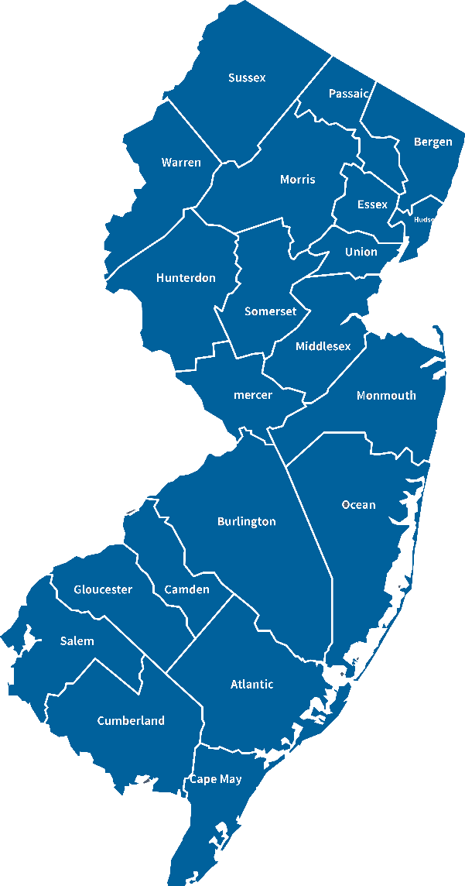
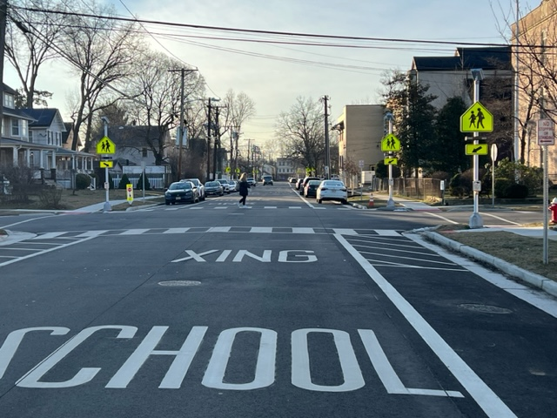
Mayor Jason F. Cilento
O: 732-882-4551
E: jcilento@dunellen-nj.gov
FB: facebook.com/MayorCilento
Instagram: @mayorcilento
CONNECTING THE DOTS
Photo by Alex Miller, 3/3/2023

Slide 2

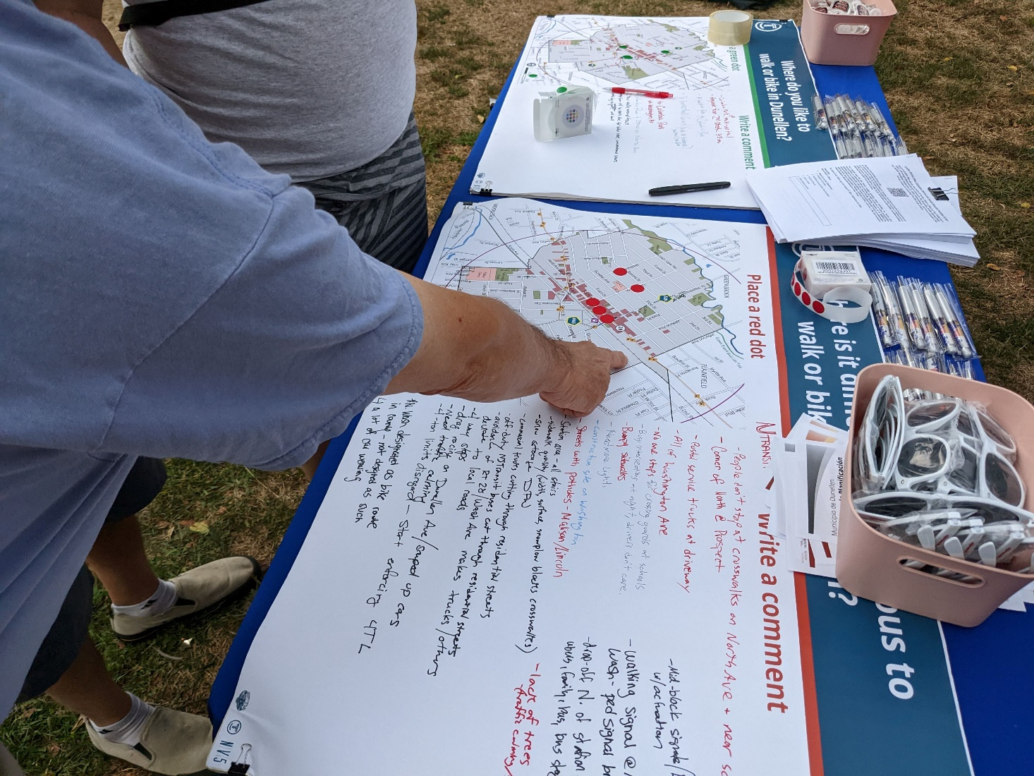
CONTENTS
  Mobilizing citizens
  Survey, assessing and planning for the future through citizen engagement
  Implementing public input
  Equity Profile & Communications Strategy
  Connecting the dots

Slide 3

MOBILIZING CITIZENS
Citizen engagement and participation have the same goal:
  improving public service deliveries and
  policy projects.
Officials must encourage citizens to:
  discuss,
  assess policies and
  contribute to projects.
For municipalities to be successful in community engagement, they must find means to:
integrate public input into its governance
– ordinances, policies, formation of committees, etc. –
Only then does engagement become formalized and
TRUST IS BUILT
with the public to participate in public outreach.
melita/Adobe Stock
Source: Citizenlab, Ilona Lodewickx, 9/10/2020, https://www.citizenlab.co/blog/civic-engagement/what-is-the-difference-between-citizen-engagement-and-participation/

Slide 4
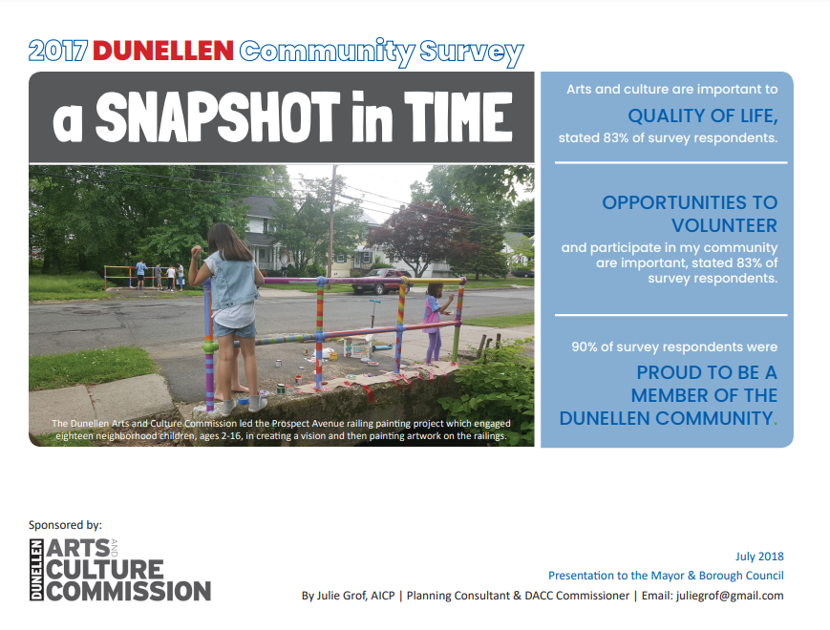
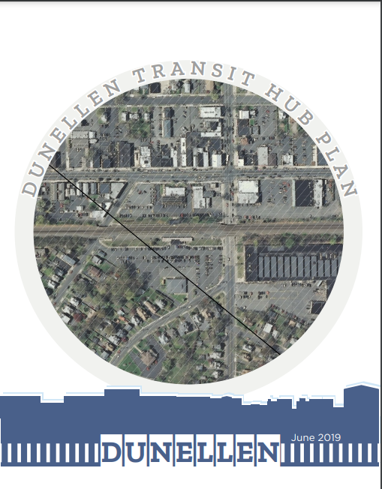
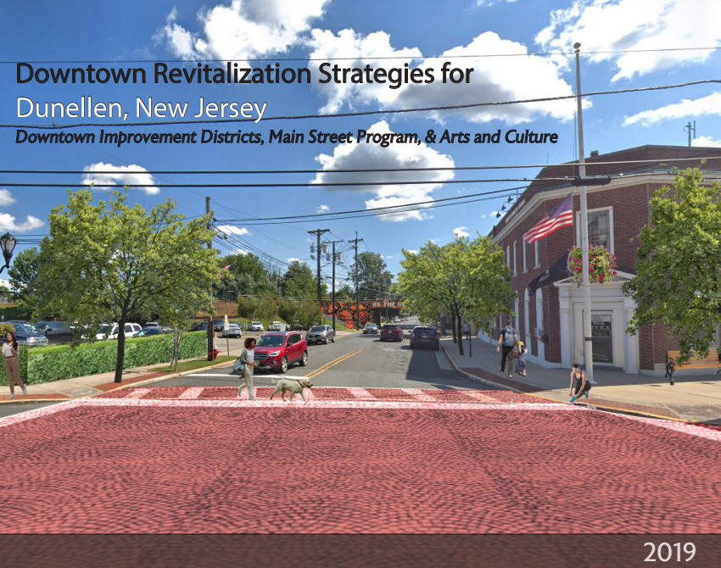
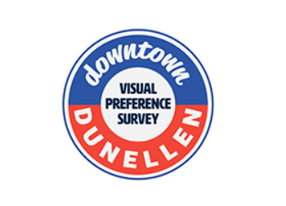
SURVEYING, ASSESSING & PLANNING
for the future through citizen engagement
2017 Dunellen Community Survey
by the Dunellen Arts and Culture Commission
2019 Dunellen Transit Hub Study
  by Together North Jersey and the North Jersey Transportation Planning Authority (NJTPA)
  2019 Downtown Revitalization Strategies for Dunellen, NJ
  by the Redevelopment Studio at the
  Edward J. Bloustein School of Planning
  and Public Policy with David Listokin, Ph.D.
  2020 High Street to Madison Avenue
  Walkable Community Workshop
  by NJTPA, Sustainable Jersey and the Alan M. Voorhees Transportation Center
  2021 Downtown Visual Preference Survey
  by DMR Architects
  2021-2022 Analysis of Murals as an Arts and Economic Revitalization Strategy
  By the Mural Studio at the Edward J. Bloustein School of Planning and Public Policy with David Listokin, Ph.D. and Mason Gross School of the Arts with Raul Ayala
  2023 Dunellen Master Plan Re-Examination and
  Climate Resiliency Plan
  by DMR Architects
  2023/24 Equity Profile and Communications Strategy

Slide 5
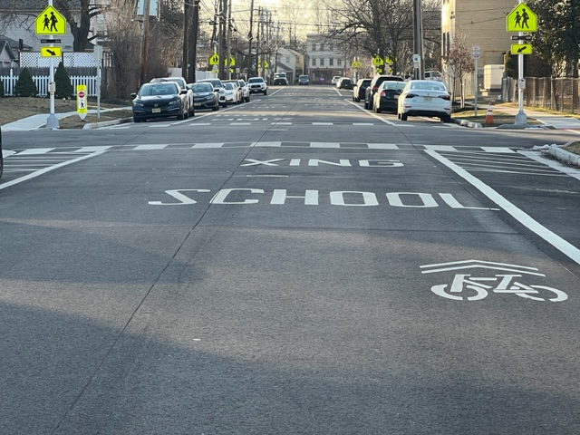
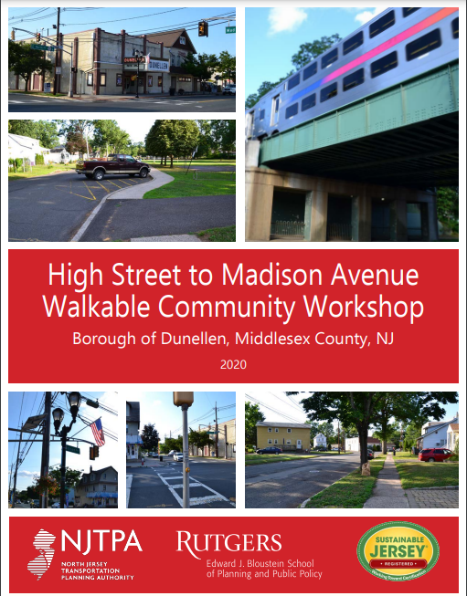
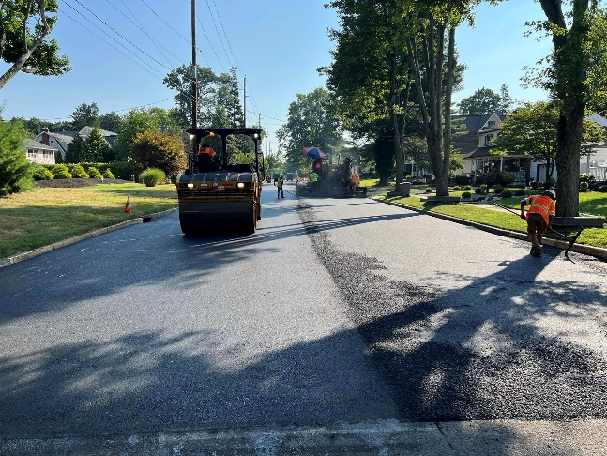
IMPLEMENTING PUBLIC INPUT
Support walking and bicycling in the community and improve safety for walkers and bicyclists:
  Enhanced striping
  Better signage
  Bike lanes and sharrows
  Rapid flashing beacon lights at key pedestrian crosswalks
  Coordinated in conjunction with r road improvements

Slide 6
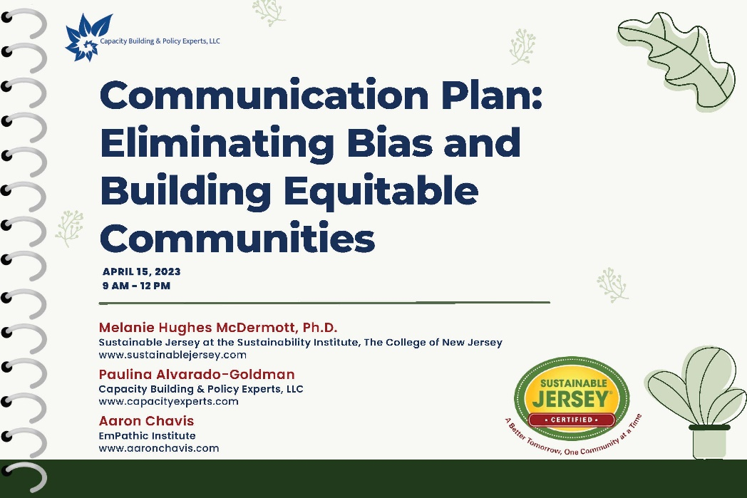
EQUITY PROFILE &
COMMUNICATIONS STRATEGY
with Sustainable Jersey
Dunellen has engaged in a communication planning process that has INTEGRATED EQUITABLE AND INCLUSIVE PRACTICES
with the goals of increasing community participation and building community trust.
The process included:
  Workshops,
  Focus groups,
  Surveys,
  Webinars, and
  Coaching sessions.

Slide 7
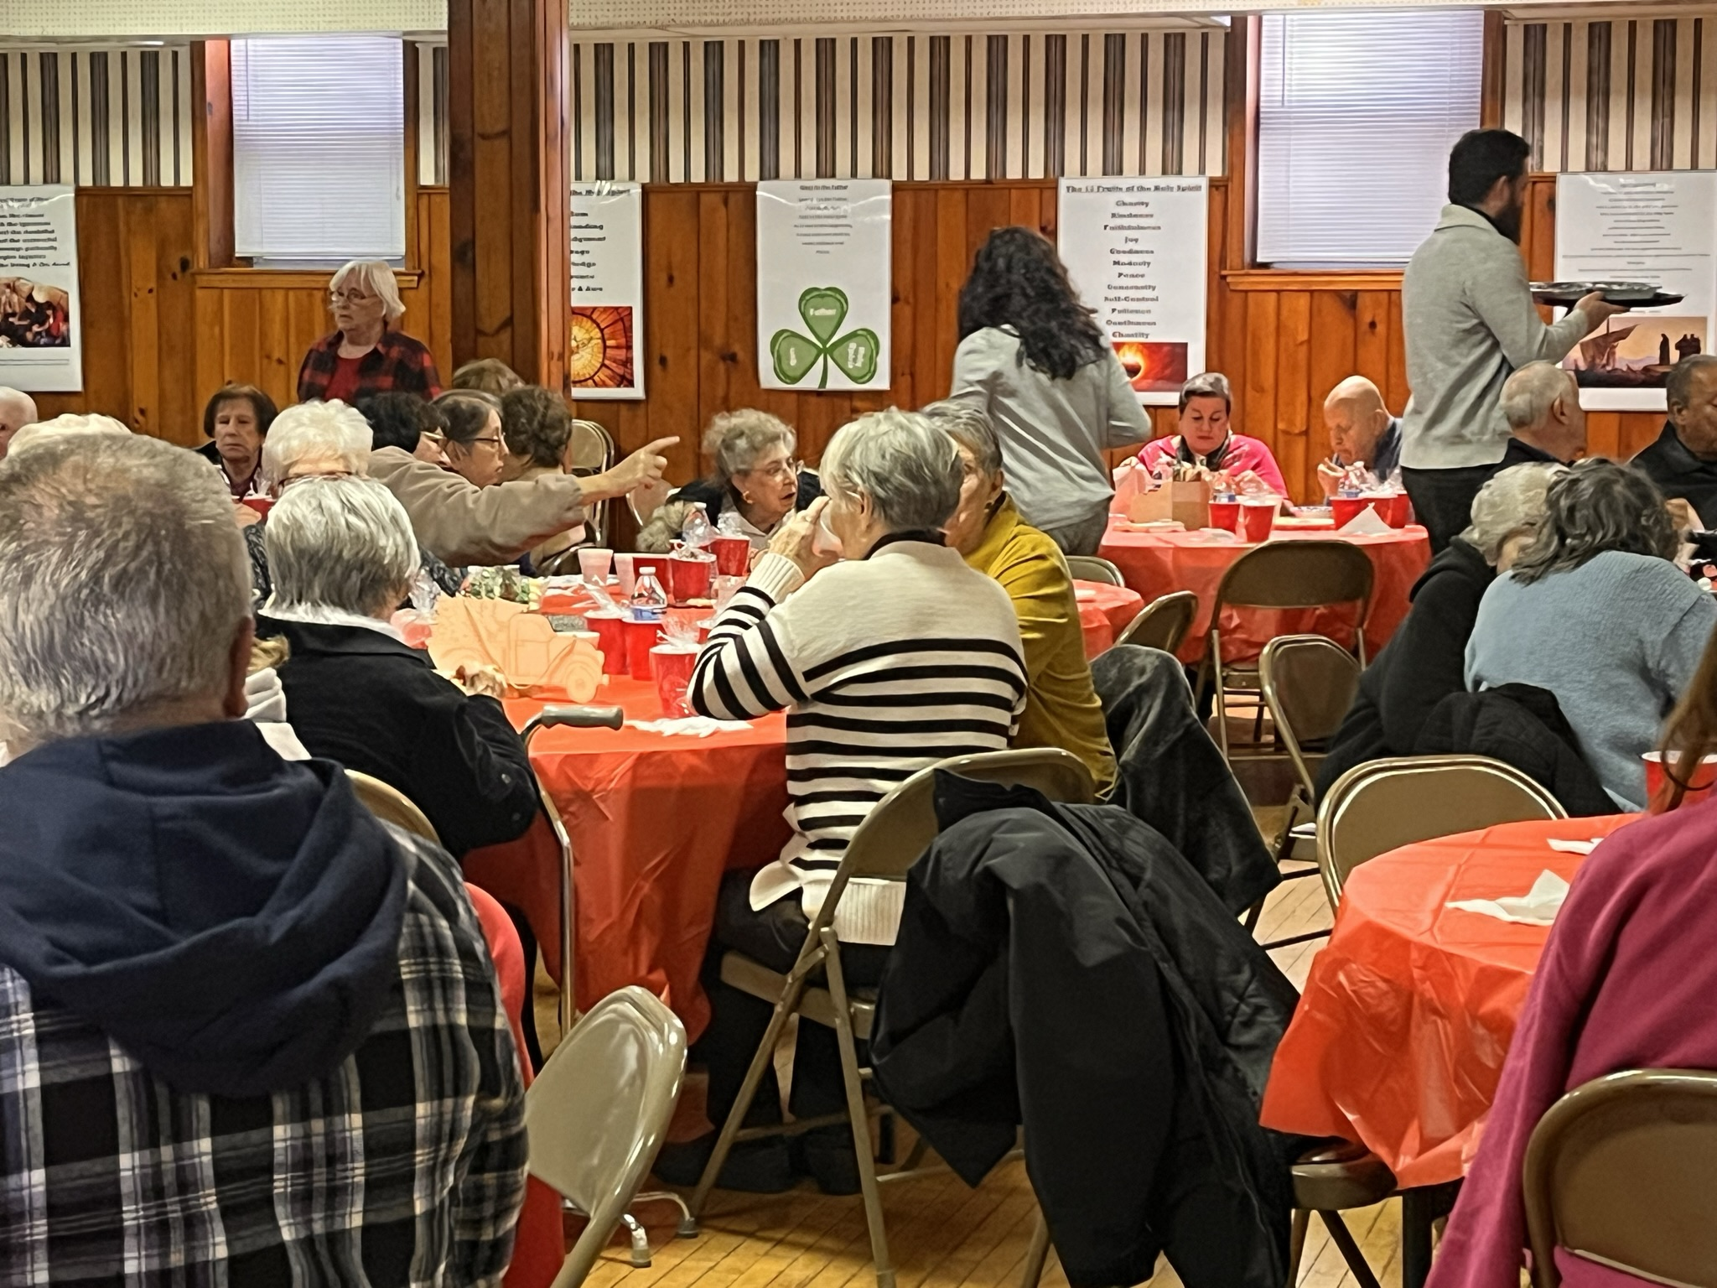
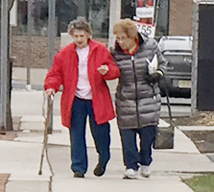
EQUITY PROFILE &
COMMUNICATIONS STRATEGY
with Sustainable Jersey
Based on information from the Sustainable Jersey Equity Profile,
five of the MOST VULNERABLE POPULATIONS in Dunellen were identified:
  People with disabilities,
  Residents living below the poverty level,
  Spanish speaking population,
  Senior citizens, and
  Adults ages 30 and younger.

Slide 8
EQUITY PROFILE &
COMMUNICATIONS STRATEGY
with Sustainable Jersey
The process has been VALUES-DRIVEN with the below principles in mind. These are the stepping stones to building a robust democratic process:
  Transparency,
  Multiculturalism,
  Inclusivity that includes racial minorities and groups beyond race,
  Building trust in government,
  Good governance,
  Accountability,
  Equity,
  Empowerment and Self-Advocacy,
  Honesty, and
  Balance old and new traditions.
These values then serve as the foundation for the 3 pillars of the Dunellen dream: 1) building relationships, 2) embracing small town vibes, and 3) innovation.

Slide 9
EQUITY PROFILE &
COMMUNICATIONS STRATEGY
with Sustainable Jersey
Dunellen ENGAGED COMMUNITY MEMBERS, COUNCIL MEMBERS, AND DUNELLEN EMPLOYEES in the development of this plan, which is still unfolding. As part of this process, Dunellen has:
  Identified potential biases that they may hold,
  Explored intersectionality and how policies, situations, and experiences can impact communities differently,
  Has conducted an inventory of existing communication sources to help in the planning process, and
  Created an inventory of the existing Dunellen population and different community needs.

Slide 10
EQUITY PROFILE &
COMMUNICATIONS STRATEGY
with Sustainable Jersey
Dunellen is triaging its PRIORITIES based on the following criteria:
  Community need,
  Logistical realities,
  Administrative realities,
  Financial realities,
  Capacity,
  Impact on workflow,
  Available resources, and
  Impact on varying communities.
An implementation timeline will then be developed accordingly that will take into consideration the steps that need to be carried out in the planning, start-up, rollout out, implementation, and monitoring phases of each priority that is identified.

Slide 11
EQUITY PROFILE &
COMMUNICATIONS STRATEGY
with Sustainable Jersey
A survey has been disseminated to the participants of the working group and the following top-ten priorities have been identified:
* This survey is still collecting data so the results will change.

Slide 12
EQUITY PROFILE &
COMMUNICATIONS STRATEGY
with Sustainable Jersey
The ultimate PRIORITIES will be selected based on:
Values alignment,
Urgency,
Impact on vulnerable communities and identified populations,
Facility of operationalization, and
Impact on community as a whole.

Slide 13
EQUITY PROFILE &
COMMUNICATIONS STRATEGY
with Sustainable Jersey
Next Steps
Final coaching session
Decisions – What will Dunellen have to consider in order to implement communication plan:
  Prioritize the priorities
  Assign money and staff to these potential initiatives
  Perform outreach to ask how vulnerable groups would like to receive information and participate
  How will this draft plan be shared with the community and how can the public provide feedback
  Establish qualitative performance outcomes of plan
?
?
?

Slide 14
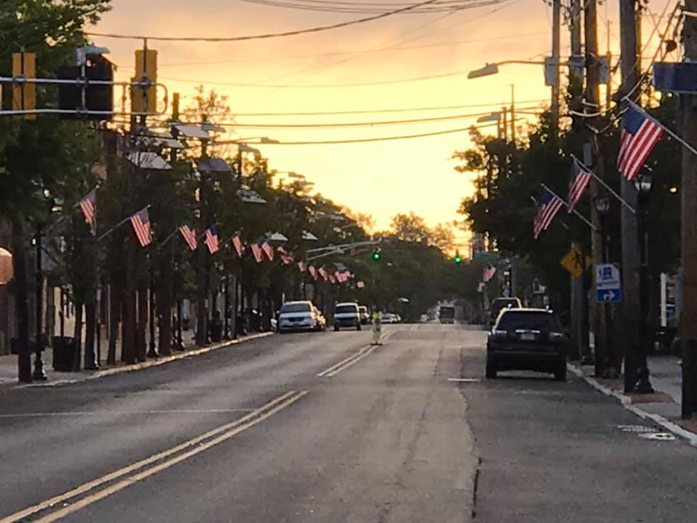
Final thoughts on how to be successful
CONNECTING THE DOTS
  If you want to engage a broader public, you need to identify who has been missing out and target your engagement strategy to include them.
  Know your community.
  Prepare for your strategy to be a living document and to periodically evaluate and reassess.
  Do not take for granted FREE advice from technical assistance grants.
Mayor Jason F. Cilento, Borough of Dunellen
O: 732-882-4551 | E: jcilento@dunellen-nj.gov
FB: facebook.com/MayorCilento | Instagram: @mayorcilento

